Slide 1
Software Defined Networking (SDN) Training
Module 5: Software Load Balancer

Slide 2
Copyright and terms of use
Copyright and trademarks
This training package is proprietary and confidential and is intended only for uses described in the training materials. Content and software is provided to you under a Non-Disclosure Agreement and cannot be distributed. Copying or disclosing all or any portion of the content and/or software included in such packages is strictly prohibited.
The contents of this package are for informational and training purposes only and are provided "as is" without warranty of any kind, whether express or implied, including but not limited to the implied warranties of merchantability, fitness for a particular purpose, and non-infringement.
Conditions and terms of use
Training package content, including URLs and other Internet Web site references, is subject to change without notice. Because Microsoft must respond to changing market conditions, the content should not be interpreted to be a commitment on the part of Microsoft, and Microsoft cannot guarantee the accuracy of any information presented after the date of publication. Unless otherwise noted, the companies, organizations, products, domain names, e-mail addresses, logos, people, places, and events depicted herein are fictitious, and no association with any real company, organization, product, domain name, e-mail address, logo, person, place, or event is intended or should be inferred.

Slide 3













Learning objectives
By the end of this module, you will be able to:

Slide 4
Understand software load balancer

Slide 5
What is Software Load Balancer?
Software Load Balancer (SLB) is a NAT-based layer-4 load balancer.
Enables load balancing for North-South and East-West TCP/UDP traffic.
Allows load balancing of public and internal network traffic.
Health probes monitor the state of resources.
Managed via SLB Manager Service within Network Controller.

Slide 6
Scale and performance
Network Controller cluster can support up to 8 SLB MUXes.
MUXes can be added and removed from the pool without impacting SLB services.
MUXes can be deployed to more than two nodes in active/active configuration.
Health monitoring is available to management endpoints.

Slide 7
Explain software load balancer architecture

Slide 8
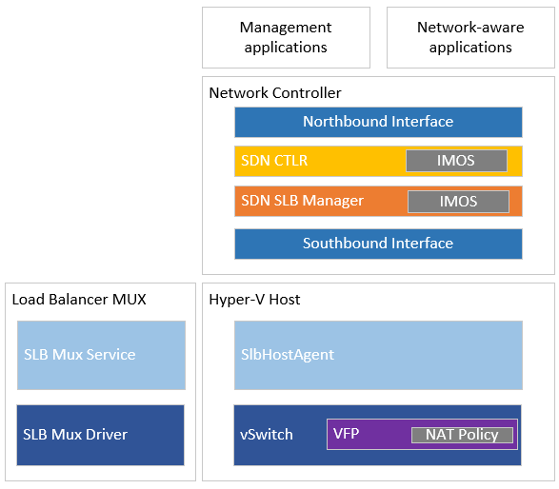
Architecture overview
SLB architecture is composed of the following resources:
SDN Controller Service.
SLB Manager Service.
Load Balancer Mux.
SLB Host Agent.
Virtual Filtering Platform (VFP).

Slide 9
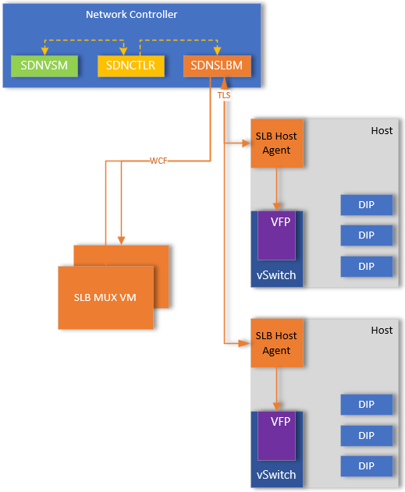
Policy configuration
Like other NC services, SDN Software Load Balancer Manager (SDNSLBM) will receive REST operations via Northbound API.
SDN API sends load balancer object to SDN Controller service.
SDN Controller sends the configuration to SLB Manager Service.
Policies are pushed from SLB Manager Service via Southbound API to SLB MUX Service and SLB Host Agent.
SLB Mux Service will program the policies in SLB MUX Driver on MUX VM.
SLB Host Agent will program policies into VFP switch extension.
Policies are configured with the MUXes as well as SLBHostAgent.
SLBHostAgent will monitor DIP endpoints and communicate to SLB Manager service if DIP is offline.
Notes:
SdnCtlr service has a component called NetworkManager (NM) that's also a part of SLB control plane. It has a KVS data store as well as an IMOS data store. Whenever we add/update/delete a LoadBalancer, SDN API calls WCF API of SdnCtlr and passes the LB object. The goal state driver sends it down to SLB Manager Service.
SLB Manager is responsible for configuration of the VIP:DIP mappings on the MUXes and Hypervisor hosts. This allows enables both inbound and outbound packet flows to leverage the VIP:DIP mappings. In addition to configuring the VFP, SLB Host Agent will monitor the DIP endpoints for any configured VIPs. In scenarios where the DIP is offline/inaccessible, SLB Host Agent will communicate this to SLB Manager Service, which in turn will push new policy configuration to reflect the DIP is not available.
SLB Manager / SLB Host Agent do not monitor for fabric notifications as it’s not their responsibility. Instead VNET service is responsible for computing the where the PA:CA mappings resides based on where the VM is placed on fabric, and will notify SLB Manager, which enables SLB Manager to update its policies. In scenarios where VM and its corresponding DIP are live migrated to new host, VSM service will be notified via Event Coordinator and will make necessary routing adjustments for virtual network, in addition to informing SLB Manager of the new PA – CA mappings.

Slide 10
SDN controller service
Receives data from the SDN API service.
Responsible for create and update operations for load balancer resources.
Communicates with vSwitch Service (VNET Manager) as well to get IP configuration details.
Once the goal state is configured, passes information to SLB Manager service for further processing.

Slide 11
SLB manager service
Receives instructions via WCF from the SDN Controller service.
Calculates Virtual IP (VIP) and Direct IP (DIP) address mappings.
Works with SLB southbound drivers responsible for southbound policy configuration to SLBHostAgent and SLBMux Service.
Leverages a combination of WCF and TLS methods for southbound policy configuration.
Provides health status of the SLB infrastructure.
Provides health status for individual VIPs.

Slide 12
SLB host agent
Receives policy configuration from SLB Manager Service over TLS.
Responsible for configuring policies within VFP.
SLB Host Agent connects to the SDN API on port 8570.
SDN API redirects SLB Host Agent to SLB Manager Service primary replica endpoint.
SLB Host Agent disconnects from SDN API and connects to SLB Manager on port 8571.
Notes:
The SLB Host Agent listens for SLB policy updates from Network Controller. In addition, the host agent programs rules for SLB into the SDN-enabled Hyper-V Virtual Switches that are configured on the local computer.
SlbHostAgent first connects to SdnApi floating IP on port 8570. This connection is unsecure. Sdnapi will redirect slbhostagent to SlbManager service primary. Then slbhostagent will disconnect from sdnapi and connect to slbmanager primary on port 8571. Whenever slbmanager primary changes this process repeats.

Slide 13
Multiplexor (MUX)
Windows VM that has the SoftwareLoadBalancer feature installed.
Processes inbound network traffic and maps the Virtual IP (VIP) to Direct IP (DIP).
Policies are pushed via SDN SLB Manager Service to MUXes via WCF over TLS/TCP 8560.
VIP:DIP mappings are stored in memory in hash table.
Flows are maintained in the MUX driver for new TCP connections using 5-tuple rule.
BGP Peering is performed by the MUX Service .
Peers with the TOR Switches and uses its own BGP implementation.
Virtual IP (VIPs) are advertised as /32 routes via BGP to the TOR switches.
Equal Cost Multi-Path (ECMP) enables load balancing of the MUXs in event of the failure, resulting in traffic being redirected to remaining MUXs.
Outbound network traffic is routed directly from hypervisor host using Direct Server Return (DSR).
Notes:
The SLB MUX processes inbound network traffic and maps VIPs to DIPs, then forwards the traffic to the correct DIP. VIP addresses are advertised as a /32 route to the TOR switches, which requires BGP Peering between the MUX and TOR in order for route propagation to occur. Outside of the BGP requirements between TOR and MUXs, customers can use whatever routing technologies and practices that are implemented in their datacenter.
BGP Keep Alive notifies MUXs when a MUX fails, which allows active MUXs to redistribute the load in case of a MUX failure. If the BGP Peering is lost between the MUX and TOR switches, the TORs will automatically update their route tables to eliminate the failed MUX from its routing. This essentially provides load balancing for the load balancers when using Equal Cost Multi Path (ECMP) as the ‘best route’ from the TOR and MUX(s) should be equal.

Slide 14
Load Balancer Manager configuration
Configuration for Load Balancer Manager (LBM) is defined under /networking/<API Version>/loadBalancerManager/config.
This contains information like LBM IP Address, NAT IP Exemptions, and IP pools.
The IP pool resource contains an array of Logical Networks resources used for fronted IP addresses.
When creating load balancer objects, IP addresses must be sourced out of the IP pool range defined within the logical network.
LBM IP is used for routing purposes by the MUX as it processes inbound packets.
Packets are encapsulated with a VXLAN header with the Source IP being the LBM IP when it’s redirected to appropriate PA IP address where the CA IP resides.
In scenarios where the VM is deployed on a Logical Network, the outer header Destination IP will be the DIP IP itself.
Notes:
A loadBalancerManager is a singleton resource, it cannot be deleted once it is created. However, it can be updated.
The loadBalancerManager IP address MUST be part of one of the vipIpPools configured on the loadbalancerManager resource.
In any update removal of an ipPool reference form vipIpPools MUST only be attempted when no loadBalancers reference IP addresses from that pool in their frontendIPConfigurations and no public IPs are allocated from that ipPool. Removal of an in use ipPool is disallowed and will place the loadbalancerManager resource in a failed provisioning state.
Similarly, if an ipPool is added for use by the loadBalancerManager, it MUST have no IP address usage prior to being added to the loadBalancerManager.

Slide 15

Lab
Examine SLB Manager service.
Examine load balancer MUXs.
Examine SLBHostAgent.
Examine Load Balancer Manager config.

Slide 16
Knowledge check
Which service(s) does the SLB Manager service distribute VIP:DIP mappings?
How are Virtual IPs (VIP) advertised to the physical network?
How is the Load Balancer Manager IP address used?
Notes:
See answers at end of the deck.

Slide 17
Understand common elements
Notes:
In this section, we talk about some common resources that are shared across the different capabilities that are exposed leveraging Software Load Balancer Manager and Load Balancer Muxes.

Slide 18
What is a public IP address?
Used to indicate the IP to communicate to resources outside of a Virtual Network.
Represented within NB API as /networking/<api version>/publicIpAddresses/{resourceId}.
Public IP address is used by virtual gateways and load balancers for load balancing.
Can be attached directly to a network interface to enable L3 inbound and outbound NAT.
A public IP can be associated to a single resource like a network interface or load balancer.

Slide 19
Public IP
Property | Description
ipAddress | The allocated IP address. The caller can pass in a specific public IP address to be allocated, or leave it empty. Supports IPv6.
publicIPAllocationMethod | Dynamic or Static. In case of Static publicIPAllocationMethod, ipAddress property needs to be passed indicating the specific public IP address that must be allocated. In case of Dynamic publicIPAllocationMethod, the ipAddress property is not meaningful in a PUT (allocation request). In case of Dynamic, any free public IP address is allocated to the caller.
dnsSettings | Indicates the DNS settings of the network interface.
IdleTimeoutInMinutes | Specifies the timeout for the TCP idle connection. The value can be set between 4 and 30 minutes. The default is 4 minutes. If public IP is used as a frontend IP of a load Balancer this value is ignored.
ipConfiguration | Reference to an ipConfigurations resource. Relative URI of the private IP address associated with the public IP. Private IP can be defined on NIC, loadBalancers, or gateways.
publicIPAddressVersion | If present, it MUST be one of the following values: - IPv6 or IPv4. The default is IPv4. - This property is supported with URI version v2 or later.
Notes:
There are multiple resources that compose a public IP address object to configure how each VIP:DIP mapping operates.

Slide 20
Idle timeout
If TCP thread goes idle, TCP flow will be terminated through MUXs.
inboundNatRules and outboundNatRules allow for idleTimeoutInMinutes to be configured between 4 and 30 minutes, in addition to setting enableTcpReset to $true or $false.
Important value to be aware of, especially for database traffic.
If enableTcpReset:$false or on older API versions:
Applications and services traversing load balancer need to leverage TCP keep-alive to keep TCP sessions active.
If idleTimeout limit is reached, TCP timeout issues happen as load balancer does not send a TCP RST, so endpoints are not aware TCP thread is no longer available.
Notes:
idleTimeout can cause issues with applications and services, especially those that are meant for database traffic where general guidance is to re-use TCP threads for performance. Applications and services need to leverage TCP keep-alive to ensure that if re-using TCP ports, that the TCP session remains active.
In Azure and Azure Stack Hub when using Basic SKU for Load Balancers, this is a common problem that when idleTimeout limit is reached the TCP flow within the MUXes is terminated, with no notification to peers that the TCP thread is no longer active. Applications and services that then attempt to re-use the TCP socket will then encounter failures as the packet will be dropped when it reaches the Load Balancer MUX.
Azure has since moved to ‘Standard’ SKU for load balancers and public IP addresses, which improve this behavior by sending RST packet when idleTimeout is reached.

Slide 21
Outbound NAT rules
Property | Description
frontendIPConfigurations | Indicates an array of frontendIPConfigurations resources. Indicates an array of references to frontendIpAddress resources.
backendAddressPool | Indicates a reference to the backendAddressPools resource. This is the pool of IP addresses where outbound traffic originates.
protocol | Protocol for outbound traffic. For transparent outbound NAT specify All. Valid values include TCP, UDP, GRE, ESP, and All.
enableTcpReset | Enables TCP connection reset when the flow times out due to inactivity. The default value is FALSE. This property is supported with URI version v3.2 and later.
Notes:
The outboundNatRules resource is used to configure the load balancer to apply Network Address Translation of outbound traffic.
It is invoked through the following URI: https://<url>/networking/v1/loadBalancers/{parentResourceId}/outboundNatRules/{resourceId}.

Slide 22
Backend address pool
Property | Description
backendIPConfigurations | Indicates an array of references to ipConfigurations resources. There is no restriction on having the same ipConfigurations in multiple backendAddressPools. An IP configuration can become a part of a backendAddressPool by setting a reference to a backendAddressPools resource in the loadBalancerBackendAddressPools array field on the ipConfigurations resource. For URI v7 and later, IP configurations can also be directly added or removed by modifying the array of ipConfigurations references,as long as the loadBalancers property updateBackendAddressPools is set to true.
loadBalancingRules | Indicates an array of references to the set of loadBalancingRules resources that use this back-end address pool.
outboundNatRules | Indicates an array of references to the set of outboundNatRules resources that use this back-end address pool.
Notes:
A backendAddressPools resource represents the list of IPs that can receive network traffic that comes via the front-end IPs. The load Balancing MUX handles incoming traffic via the front-end IPs and distributes them to back-end IPs based on load balancing configuration.
It is invoked through the following URI: https://<url>/networking/v1/loadBalancers/{parentResourceId}/backendAddressPools/{resourceId}.

Slide 23
Knowledge check
To which resource(s) can the public IP address be attached?
What is a backend address pool used for?
Notes:
See answers at end of the deck.

Slide 24
Understand load balancer

Slide 25
What is a load balancer?
The loadbalancers resource allows configuration of the distribution of traffic across VMs hosted in the environment.
Represented within NB API as /networking/<api version>/loadbalancers/{resourceId}.
Composed of frontend and backend configurations.
Frontend configuration exposes the IP address of the load balancer.
Can be either a public or private VIP address.
Can be statically or dynamically allocated.
The backend configuration identifies the workload VMs that deliver the traffic.
Probes can be defined as part of the backend configuration to help determine the health state of endpoints and eliminate instance from load balancing distribution, if unhealthy.
Notes:
The loadBalancers resource allows fine-grained configuration of the distribution of incoming traffic across VM instances that are hosted in the environment managed by the server. This resource has two main parts: a frontend and a backend configuration.
The frontend configuration exposes the IP address of the load balancer. For example, this address can be a reserved public or private IP address previously provided to the client, or it can be an IP address that is dynamically allocated from a subnet of a virtual network.
The backend configuration identifies the tenant workload VMs to which the traffic will be delivered.
Probes define how the loadBalancer determines the health of a specific VM instance or endpoint of that instance. The loadBalancer sends traffic to a VM instance or endpoint only if the VM instance or endpoint was determined to be healthy.
A load balancing rule refers to a frontend configuration, a backend configuration and optionally to a probes resource to create a mapping between Virtual IP and a set of workload VMs. Traffic directed to the VIP is then load-balanced onto one of the workload VMs. Linkage to Other Resources
When a port of a specific frontend IP address sends traffic to the loadBalancers resource, the loadBalancers resource distributes the traffic to a specific port of a set of backend IP addresses. The backend IP addresses are associated with network interface cards (NICs) of VMs. Backend IP addresses in the loadBalancers resource are specified as references to these private IPs.
A public IP address can be associated with the private frontend IP of the loadBalancers resource by setting an ipConfigurationRef on the publicIPAddresses resource.
The resources that MUST be unique in the context of the parent loadBalancers resource are: backendAddressPools, frontendIPConfigurations, inboundNatRules, loadBalancingRules, outboundNatRules, probe.

Slide 26
Load balancer properties
Property | Description
loadBalancers | The loadBalancers resource allows fine-grained configuration of the distribution of incoming traffic across VM instances that are hosted in the environment managed by the server.
backendAddressPools | A backendAddressPools resource represents the list of IPs that can receive network traffic that comes via front-end IPs. The load Balancing MUX handles incoming traffic via the front-end IPs and distributes them to backend IPs based on the load balancing configuration.
frontendIPConfigurations | The frontendIPConfigurations resource represents the frontend IP addresses of the load balancer. Either a publicIPAddress or a privateIPAddress and subnet MUST be configured.
inboundNatRules | The inboundNatRules resource is used to configure the load balancer to apply Network Address Translation (NAT) of inbound traffic.
loadBalancingRules | The loadBalancingRules resource is used to configure load balancing policies. The policies dictate the kind of traffic that is load-balanced, and port mapping between frontend IPs and backend IPs.
outboundNatRules | The outboundNatRules resource is used to configure the load balancer to apply Network Address Translation of outbound traffic.
probes | Probes resources are used to configure the mechanism of detection of connectivity issues with load balanced IPs.
Notes:
There are multiple resources that compose a load balancer object to configure how each VIP:DIP mapping operates.
The load balancer is primarily composed of:
Backend Address Pool
Frontend IP Configuration
Inbound NAT Rule
Load Balancing Rule
Outbound NAT Rule
Health Probes

Slide 27
Frontend IP configuration (1 of 2)
Property | Description
inboundNatRules | Indicates a reference to the inboundNatRules resource used by the frontEndIPConfigurations resource.
loadBalancingRules | Indicates a reference to the loadBalancingRules resource used by the frontendIPConfigurations resource.
outboundNatRules | Indicates a reference to the outboundNatRules resource used by the frontendIPConfigurations resource.
publicIPAddress | Indicates a reference to the publicIPAddresses resource (section 3.1.5.14) used by the frontendIPConfigurations resource. If a publicIPAddress is specified, then a privateIPaddress is not specified. When a publicIPAddress is specified, the privateIPAllocationMethod is set to Dynamic. IPv6 addresses are supported with URI version v2 or later.
Notes:
The frontendIPConfigurations resource represents the front-end IP addresses of the load balancer. Either a publicIPAddress or a privateIPAddress and subnet MUST be configured.
It is invoked through the following URI: https://<url>/networking/v1/loadBalancers/{parentResourceId}/frontendIPConfigurations/{resourceId}.

Slide 28
Frontend IP configuration (2 of 2)
Property | Description
privateIPAddress | Specified only if a specific private IP address identifies an IP address that is statically configured for use with this frontendIPConfigurations resource. The privateIPAllocationMethod MUST be allocated static for this case. If a privateIPAddress is specified, a reference to a publicIPaddress can’t be specified at the same time. The private IP address can be either from the infrastructure address space or from a tenant address space. In either case, they MUST be accompanied with a valid subnet specified in the subnet element reference. IPv6 addresses are supported with URI version v2 or later.
privateIPAllocationMethod | Static or Dynamic.
subnet | Indicates a reference to the subnet resource used by the frontendIPConfigurations resource. MUST be specified if a privateIPaddress is specified. A subnet reference to a logical network subnet is needed if the privateIPAddress is from the infrastructure address space. A subnet reference to a virtual network subnet is needed if the privateIPAddress is from a tenant address space. The subnet MUST include the IP address specified in privateIPAddress.
Notes:
The frontendIPConfigurations resource represents the front-end IP addresses of the load balancer. Either a publicIPAddress or a privateIPAddress and subnet MUST be configured.
It is invoked through the following URI: https://<url>/networking/v1/loadBalancers/{parentResourceId}/frontendIPConfigurations/{resourceId}.

Slide 29
Load balancing rule (1 of 3)
Property | Description
backendAddressPool | Indicates an array of references to a backendAddressPools resource. Inbound traffic is randomly load balanced across IPs in the backend pool.
backendPort | Indicates the port used for internal connections on the endpoint. The localPort attribute maps the external port on the endpoint to an internal port on a role. This is useful in scenarios where a role has to communicate to an internal component on a port that is different from the one that is exposed externally. If not specified, the value of localPort is the same as the port attribute. Set the value of localPort to asterisk (*) to automatically assign an unallocated port that is discoverable using the runtime API. Possible values range between 1 and 65535, inclusive. This parameter is required if the protocol is TCP or UDP.
frontendIPConfigurations | Indicates an array of references to frontendIpAddress resources.
frontendPort | Indicates the port for the external endpoint. Possible values range between 1 and 65535, inclusive. This value MUST be unique for the loadBalancers resource. This parameter is required if the protocol is TCP or UDP.
Notes:
The loadBalancingRules resource is used to configure load balancing policies. The policies dictate the kind of traffic that is load-balanced, and port mapping between front-end IPs and back-end IPs.
It is invoked through the following URI: https://<url>/networking/v1/loadBalancers/{parentResourceId}/loadBalancingRules/{resourceId}.

Slide 30
Load balancing rule (2 of 3)
Property | Description
idleTimeoutInMinutes | Indicates the timeout for the TCP idle connection in the inbound direction – that is, a connection initiated by an internet client to a VIP. The value can be set between 4 and 30 minutes. The default value is 4 minutes.
Protocol | Indicates the inbound transport protocol for the external endpoint. Valid values include UDP, TCP, GRE, ESP, and ALL.
enableFloatingIP | This specifies that a floating IP (VIP) is used on the available servers behind a loadBalancer. Floating IP will be forwarded by the loadBalancer to the backend server. The back-end server will be configured with that VIP, a datacenter IP, and weakhost forwarding. Floating IP configuration is required if you are using the SQL AlwaysOn Availability Group feature. This setting can't be changed after you create the endpoint.
enableTcpReset | Enables TCP connection reset when the flow times out due to inactivity. The default value is FALSE. This property is supported with URI version v3.2 or later.
Notes:
The loadBalancingRules resource is used to configure load balancing policies. The policies dictate the kind of traffic that is load-balanced, and port mapping between front-end IPs and back-end IPs.
It is invoked through the following URI: https://<url>/networking/v1/loadBalancers/{parentResourceId}/loadBalancingRules/{resourceId}.

Slide 31
Load balancing rule (3 of 3)
Property | Description
loadDistribution | This specifies the load balancing distribution type to be used by the loadBalancer. The loadBalancer uses a distribution algorithm which is a 5-tuple (source IP, source port, destination IP, destination port, protocol type) hash to map traffic to available servers. It provides stickiness only within a transport session, a feature that routes the requests for a specific session to the same physical machine that serviced the first request for that session. Packets in the same TCP or UDP session are directed to the same datacenter IP instance behind the load balanced endpoint. When the client closes and re-opens the connection or starts a new session from the same source IP, the source port changes and causes the traffic to go to a different datacenter IP endpoint. The loadBalancer can be configured to use a 2-tuple (Source IP, Destination IP) or 3-tuple (Source IP, Destination IP, Protocol) to map traffic to the available servers. By using SourceIPProtocol, connections initiated from the same client computer go to the same datacenter IP endpoint. Default: The loadBalancer is configured to use a 5-tuple hash to map traffic to available servers. SourceIP: The loadBalancer is configured to use a 2-tuple hash to map traffic to available servers. SourceIPProtocol: The loadBalancer is configured to use a 3-tuple hash to map traffic to available servers.
Notes:
The loadBalancingRules resource is used to configure load balancing policies. The policies dictate the kind of traffic that is load-balanced, and port mapping between front-end IPs and back-end IPs.
It is invoked through the following URI: https://<url>/networking/v1/loadBalancers/{parentResourceId}/loadBalancingRules/{resourceId}.

Slide 32
How does load balancing work?
Works by mapping a virtual IP (VIP) address to Direct IP (DIP) address(es).
VIPs are single IP addresses that provide access to a set of load balanced VMs.
DIPs are the IP addresses of the NICs attached to VMs that are hosting the endpoint.
VIPs are advertised via the MUX to TOR as a /32 route.
MUX knows how to map VIPs to DIPs because of load balancing policies pushed from SLB Manager within NC.
Rules like protocol, front-end port, back-end port and distribution algorithm determine how MUX should process the traffic.
When DIP responds, NAT is performed on the Hyper-V host based on same VIP:DIP policy mappings resulting in return path bypassing the MUX entirely. This is referred to as Direct Server Return (DSR).
Notes:
The Windows Server SLB enables multiple servers to host the same workload, providing high availability and scalability. SLB works by mapping virtual IP addresses (VIPs) to Direct IP addresses (DIPs) that are part of a cloud service set of resources in the datacenter.
VIPs are single IP addresses that provide public access to a pool of load balanced VMs. For example, VIPs are IP addresses that are exposed on the Internet so that tenants and tenant customers can connect to tenant resources in the cloud datacenter.
DIPs are the IP addresses of the member VMs of a load balanced pool behind the VIP. DIPs are assigned within the cloud infrastructure to the tenant resources.
VIPs are located in the SLB Multiplexer (MUX). The MUX consists of one or more virtual machines (VMs). Network Controller provides each MUX with each VIP, and each MUX in turn uses Border Gateway Protocol (BGP) to advertise each VIP to routers on the physical network as a /32 route. BGP allows the physical network routers to:
Learn that a VIP is available on each MUX, even if the MUXes are on different subnets in a layer 3 network.
Spread the load for each VIP across all available MUXes using Equal Cost Multi-Path (ECMP) routing.
Automatically detect a MUX failure or removal and stop sending traffic to the failed MUX.
Spread the load from the failed or removed MUX across the healthy MUXes.
When public traffic arrives from the Internet, the SLB MUX examines the traffic, which contains the VIP as a destination, and maps and rewrites the traffic so that it will arrive at an individual DIP. For inbound network traffic, this transaction is performed in a two-step process that is split between the MUX virtual machines (VMs) and the Hyper-V host where the destination DIP is located:
Load balance - the MUX uses the VIP to select a DIP, encapsulates the packet, and forwards the traffic to the Hyper-V host where the DIP is located.
Network Address Translation (NAT) - the Hyper-V host removes encapsulation from the packet, translates the VIP to a DIP, remaps the ports, and forwards the packet to the DIP VM.
The MUX knows how to map VIPs to the correct DIPs because of load balancing policies that you define by using Network Controller. These rules include Protocol, Front-end Port, Back-end port, and distribution algorithm (5, 3, or 2 tuples).
When tenant VMs respond and send outbound network traffic back to the Internet or remote tenant locations, because the NAT is performed by the Hyper-V host, the traffic bypasses the MUX and goes directly to the edge router from the Hyper-V host. This MUX bypass process is called Direct Server Return (DSR).

Slide 33
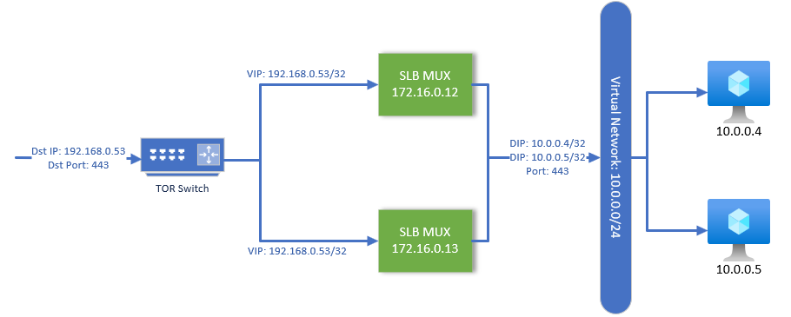
Load balancer details
Enables inbound connectivity to endpoint(s) that are load balanced across virtual machines in backend pool.
DIPs within backend address pool will use VIP for external communications.
Notes:
This diagram represents a common load balancing method strategy where a customer has deployed a set of servers hosting and endpoint (such as website) and they have created a backend load balancing pool. The endpoint is exposed via public VIP address which is advertised by the MUXes to the TOR switches.
When an incoming request is received by the TOR switch, it will route to the MUX using the best route possible. As both routes are equally weighted, this is referred to as Equal Cost Multi Path (ECMP) routing.
ECMP is a routing strategy where next-hop packet forwarding to a single destination can occur over multiple "best paths" which tie for top place in routing metric calculations. Multi-path routing can be used in conjunction with most routing protocols, because it is a per-hop decision limited to a single router. It can substantially increase bandwidth by load-balancing traffic over multiple paths.
Packet will be forwarded to one of the MUXes which will perform packet processing and redirect the packet to the appropriate backend DIP address.

Slide 34
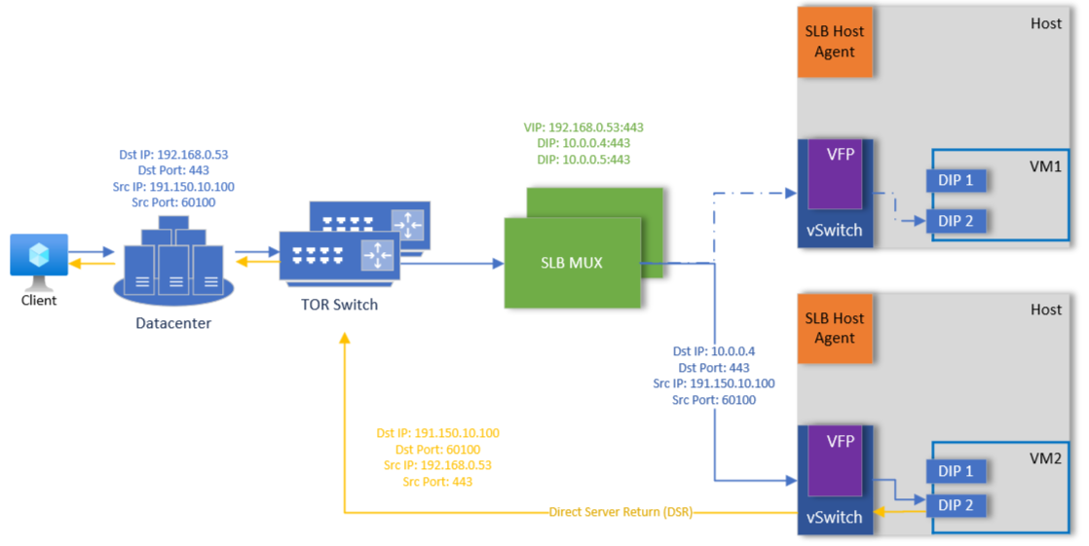
Load balancer (Datapath)
Notes:
Animation: Click to start packet flow
This diagram is a basic representation of the network datapath for traffic routing through the SLB MUXes for VIPs in scenario of using Public VIP, or sometimes referred to as North/South. This only shows the customer address space and does not factor any provider address mappings or network infrastructure.
In this example, there is a VIP address that is being advertised to the TOR Switches. The VIP itself has two backend DIPs which represent the Customer Address IP associated with their virtual machines. When the TOR switches receive the incoming packet, they will do a ‘best route’ calculation to determine the next device to forward the packet to. Since both MUXes are advertising the VIP and are equally weighted, the TOR that received the packet can pass to whichever MUX.
The MUX will receive the packet and perform the hash lookup of the VIP to determine the appropriate DIP mapping that the packet should be routed to. It will perform some packet encapsulation and header modification to send the packet to the appropriate Provider Address mapping that is hosting the Customer Address (CA). In the scenario of workload using Logical Network / Logical Subnets with VLAN, it will still do VXLAN encapsulation of the packets, however the outer IP header destination IP will be the DIP IP, rather than the PA IP.
Host will receive the packet, de-encapsulate the packet and deliver to the DIP.
DIP will send return packet. As the host already is aware of the VIP:DIP mapping based on the VFP rules programmed by SLB Manager / SLB Host Agent previously, it will perform the Source NAT translation (SNAT) and encap the packet with the appropriate header information. This enables the packet to be routed back to the TOR switch directly, without having to traverse the MUXes.

Slide 35
Health probes
Load balancer rules require a health probe to detect endpoint status.
Configuration of the health probe determines which backend pool instances receive new connections.
Health probes can be used to detect failures and redirect requests automatically.
When health probe fails, MUXs will stop sending traffic to unhealthy endpoints.
An unhealthy resource only impacts incoming traffic defined for the rule.
Health probes support TCP and HTTP.
Health probes are handled directly by SLBHostAgent. State results are communicated to SLB Manager Service. SLB Manager will handle programming of VIP:DIP mappings if a backend resource is down.
Notes:
Load Balancer health probe is a feature that detects the health status of your application instances. It sends a request to the instances to check if they are available and responding to requests.
The health probe can be configured to use different protocols such as TCP or HTTP. It is an important feature because it helps you to detect application failures, manage load, and plan for downtime.
When you create a Load Balancer, health probes are required to detect the endpoint status. The configuration of the health probe and probe responses determines which backend pool instances receive new connections.
Use health probes to detect the failure of an application. When a health probe fails, the load balancer stops sending new connections to the respective unhealthy instance. Outbound connectivity isn't affected, only inbound.

Slide 36
Probes resource
Property | Description
intervalInSeconds | Indicates the interval, in seconds, for how frequently to probe the endpoint for health status. Typically, the interval SHOULD<12> is slightly less than half the allocated timeout period (in seconds), which allows two full probes before taking the instance out of rotation.
loadBalancingRules | Indicates an array of references to loadBalancingRule resources that use this probe.
numberOfProbes | Indicates the timeout period, in seconds, applied to the probe where no response and results in stopping further traffic from being delivered to the endpoint. This value allows endpoints to be taken out of rotation faster or slower than the typical times (which are the defaults). The default value is 31 seconds, the minimum value is 11 seconds.
protocol | Indicates the protocol of the endpoint. Valid values are HTTP or TCP. If TCP is specified, a received ACK is required for the probe to be successful. If HTTP is specified, a 200 (OK) response from the specified URI is required for the probe to be successful.
port | Indicates the port for communicating the probe. Possible values range from 1 to 65535, inclusive.
requestPath | Indicates the URI used for requesting health status from the VM. path is required if protocol is set to HTTP. Otherwise, it is not allowed. There is no default value.
Notes:
It is invoked through the following URI. https://<url>/networking/v1/loadBalancers/{parentResourceId}/probes/{resourceId}.

Slide 37
Probe protocol (1 of 2)
Scenario | TCP probe | HTTP probe
Overview | TCP probes initiate a connection by performing a three-way open TCP handshake with the defined port. TCP probes terminate a connection with a four-way close TCP handshake. | HTTP issue a GET with the specified path. Relative paths for the HTTP GET are supported.
Probe down behavior | A TCP probe fails when: The TCP listener on the instance doesn't respond at all during the timeout period. A probe is marked down based on the number of timed-out probe requests, which were configured to go unanswered before marking down the probe. The probe receives a TCP reset from the instance. | An HTTP probe fails when: Probe endpoint returns an HTTP response code other than 200 (for example, 403, 404, or 500). Probe endpoint doesn't respond at all during the minimum of the probe interval and 30-second timeout period. Multiple probe requests might go unanswered before the probe gets marked as not running and until the sum of all timeout intervals has been reached. Probe endpoint closes the connection via a TCP reset.

Slide 38
Probe protocol (2 of 2)
Scenario | TCP probe | HTTP probe
Probe up behavior | TCP health probes are considered healthy and mark the backend endpoint as healthy when: The health probe is successful once after the VM boots. Any backend endpoint that has achieved a healthy state is eligible for receiving new flows. | The health probe is marked up when the instance responds with an HTTP status 200 within the timeout period. Considered healthy and mark the backend endpoint as healthy when: The health probe is successful once after the VM boots. Any backend endpoint that has achieved a healthy state is eligible for receiving new flows.

Slide 39
Probe down behavior
Scenario | TCP Connections | UDP datagrams
Single instance probes down | New TCP connections succeed to the remaining healthy backend endpoint(s). Established TCP connections to backend endpoint will continue. | Existing UDP flows move to another healthy instance in the backend pool.
All instances probe down | VIP will be marked as down and removed from BGP advertisement from MUX to Peer Router. No new TCP connections are accepted. All existing TCP connections are terminated. | All existing UDP flows terminate.

Slide 40
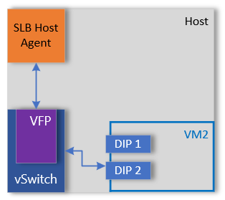
Health probes (VNET)
Notes:
Animation: Click to start packet flow
In this animation, we can see the SlbHostAgent service is responsible for sending the health probes to the configured service endpoints.
In scenarios where the VMs are deployed against a Virtual Network, the health probe is injected directly into the vPort via the Distributed Router that is programmed for the Virtual Network, thereby eliminating any network datapath routes on the physical network.

Slide 41
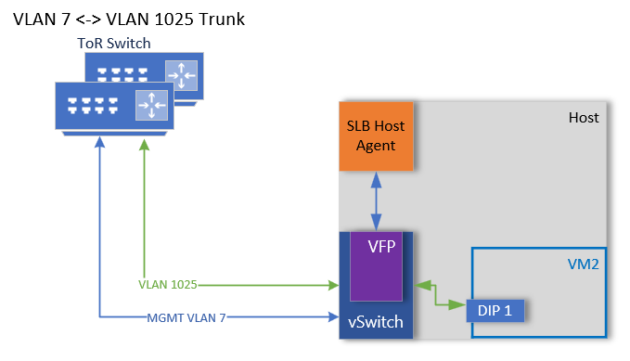
Health probes (LNET)
Notes:
Animation: Click to start packet flow
In this animation, we can see the SlbHostAgent service is responsible for sending the health probes to the configured service endpoints.
In scenarios where workloads are deployed against a Logical Network / Subnet and VLANs are in use, there may be additional datapath routing to account for. Since there is no default Distributed Router configured, the Health Probe from SlbHostAgent will be handed to the Management Interface for the Host to determine best route. In this scenario, if management network is not on the same network as the workload, then packet will be routed to the Default Gateway of the Management interface.
In this scenario, VLAN Trunk must be configured between the Management Network and the Logical Subnet that the workload is deployed on for the health probe to be routed correctly.

Slide 42
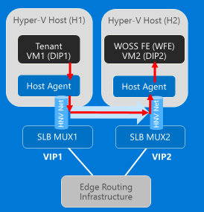
MUX bypass (VNET)
SLB MUX notifies SLB Host Agent using ICMP Redirect.
SLB Host Agent programs VFP to enable direct connectivity between the Direct IPs (DIPs).
Traffic between the two DIPs is then routed directly between the Provider Addresses (PA) vs traversing through the MUXs.
Notes:
In scenarios where the Source and Destination are VIPs managed by SLB Manager, MUXes will inform SLBHostAgent using ICMP Redirect to bypass the MUX and instead route the packet to the appropriate Provider Address that is hosting the destination DIP. SLBHostAgent is then responsible for configuring the VFP policies on the host, with the appropriate VFP details for direct routing.
Once endpoints have been notified by the MUXes, traffic should flow directly between the two DIPs using the respective Provider Address where the Customer Address is located.

Slide 43
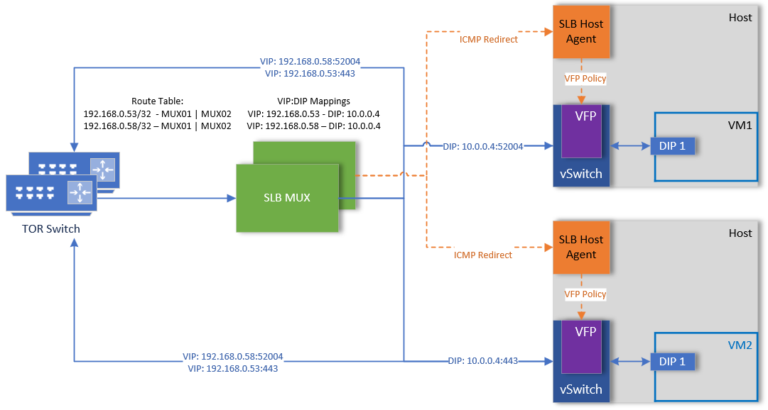
MUX bypass (Datapath)
Notes:
Animation: Click to start packet flow
In this example VM1 DIP1 is performing TCP SYN to VIP 192.168.0.53:443 which is acting as L3 NAT for VM2 DIP1. Traffic will be Source NATed (SNAT) to the VIP associated with VM1 DIP1 (192.168.0.58) and delivered to the TOR switches that HOSTs are physically cabled to. TOR will see within it’s route table, that MUX01 and MUX02 are advertising via BGP they have an available route. TOR will deliver the packet to one of the MUXes, which will then redirect and encapsulate packet with appropriate VXLAN header information, to route the packet to the corresponding host that is hosting the VM2 DIP1. In addition, since the MUX sees that both the source and destination addresses are VIPs within it’s VIP:DIP mappings, it will send ICMP redirect to SLBHostAgent. SLBHostAgent will make the appropriate VFP policy mappings for subsequent communications to that VIP.
VM2 DIP1 will receive the packet and send a SYN ACK back. The packet will be SNATed with the VIP associated with VM2 DIP1 (192.168.0.53) and delivered to TOR switches. Like the previous packet, TOR will see the route being advertised by MUX01 and MUX02, and route accordingly to get the packet delivered to host that is hosting VM1 DIP1. SLB MUX will send ICMP redirect as well to SLBHostAgent and VFP policies will be updated accordingly.
Subsequent communications now between VM1 and VM2, will now bypass the MUXes entirely and be routed directly between the VMs using the Provider Addresses (PA) logical network.

Slide 44
Lab
Create public IP address.
Create load balancer with health probes.
Examine routes on TOR.

Slide 45
Knowledge check
What protocol does Load Balancer Health Probes support?
What distribution algorithms exist to distribute traffic to backend pool resources?
What happens to existing traffic when health probe marks a backend resource as down?
Notes:
See answers at end of the deck.

Slide 46
Understand L3 forwarding

Slide 47
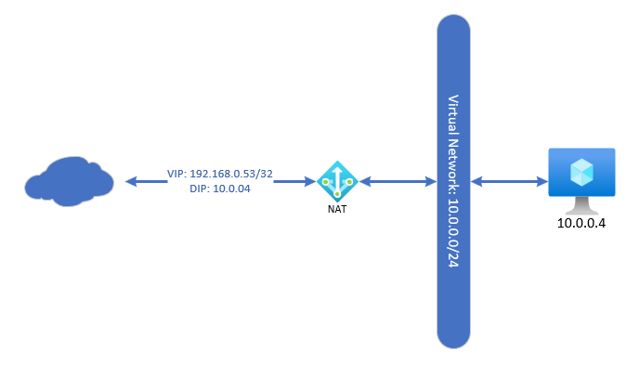
L3 forwarding
Achieved by attaching a publicIpAddress resource to networkInterface.
Enables inbound/outbound connectivity external resources to the VM associated with networkInterface.
A public IP associated with VM, is 1:1 relationship and implemented as a stateless 1:1 NAT.
Commonly referred to as an Instance-Level Public IP (ILPIP) in Azure.
For outbound flows, this public IP address takes precedent.
Has all ephemeral ports available and does not matter if the VM is load balanced or not.
Notes:
Simple Inbound NAT scenario where external traffic is able to communicate to a VM (associated with interface) using a public IP address.
Public IP is associated directly with an ipConfiguration within a Network Interface object.

Slide 48
Lab
Create a public IP address and enable TNC to public internet.
Create L3 forwarding for NIC.

Slide 49
Knowledge check
What ports are exposed with an instance-level public IP?
Notes:
See answers at end of the deck.

Slide 50
Understand outbound NAT

Slide 51
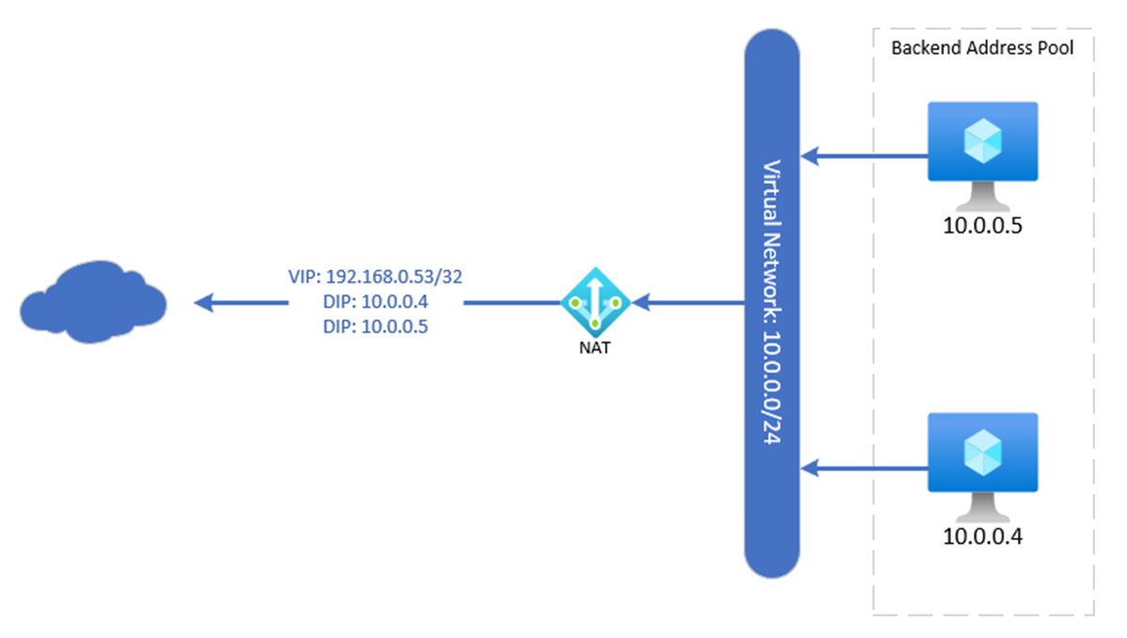
Outbound NAT
Forwards traffic from network interface to external destination.
Can be applied to single or multiple network interfaces.
Used for outbound connectivity only, with no direct access inbound.
In Azure Stack Hub and Azure, this is commonly referred to as default outbound access.
Ephemeral ports for the VIP are shared by resources for outbound and have higher probability of encountering SNAT exhaustion.
Notes:
Outbound NAT allows you to configure backend address pools to have multiple network interfaces as part of the pool. VMs are able to communicate out externally, however no inbound connections from external locations are allowed. In Azure / Azure Stack, this is referred to as default outbound access where the entire virtual network leverages an outbound pool to provide basic external communications. Issues such as SNAT exhaustion are common problems and recommended to not be using this for production service endpoints.

Slide 52
Knowledge check
If ipConfiguration is associated to outbound NAT, can it accept incoming requests?
Notes:
See answers at end of the deck.

Slide 53
Understand component tracing

Slide 54
ETW logs
Manifest-style ETW messages.
ETW events are logged on the MUXs as well as on the Hypervisor hosts.
MUX tracing includes data related to packet processing.
Hypervisor tracing includes data related to programming VIPs and is enabled by default.
ETW traces are binary and must be decoded to make them human readable.
Need to be decoded by NETSH.
For reliable decoding, must be decoded on the box where the trace was captured.

Slide 55
SLB manager trace logging
As SLB Manager is part of the Network Controller, refer to the M1_Network_Controller module regarding trace logging.

Slide 56
MUX ETW providers
Provider | GUID | Enabled
Microsoft-Windows-SlbMuxDriver | 645B8679-5451-4C36-9857-A90E7DBF97BC | Optional
Microsoft-Windows-SlbMux | 6C2350F8-F827-4B74-AD0C-714A92E22576 | Default
Some of the providers are enabled by default.
These will be contained within the C:\Windows\Tracing\SdnDiagnostics\Logs directory.
The optional providers need to be enabled manually. They capture a lot of data, so only recommended to enable for debug purposes when troubleshooting.
Start SdnNetshTrace · microsoft/SdnDiagnostics Wiki (github.com).
Stop SdnNetshTrace · microsoft/SdnDiagnostics Wiki (github.com).
Start SdnEtwTraceCapture · microsoft/SdnDiagnostics Wiki (github.com).
Stop SdnEtwTraceCapture · microsoft/SdnDiagnostics Wiki (github.com).

Slide 57
Host ETW providers
Provider | GUID | Enabled
Microsoft-Windows-SoftwareLoadBalancer-HostPlugin | 2380C5EE-AB89-4D14-B2E6-142200CB703C | Default
Microsoft.Windows.Networking.SlbHostPlugin | 8C9B3AFD-0666-5ACE-6F3F-F2C46AE92584 | Default
ETW tracing for these providers is enabled by default when Server is added to the SDN fabric.
Contained within the C:\Windows\Tracing\SdnDiagnostics\Logs directory.

Slide 58
Event logs
Admin and Operational channel logs are automatically enabled for the SLB MUX and SLB Host Agent.
MUX VM
Event Viewer\Applications and ServiceLogs\Microsoft\Windows\SLBMux.
Hyper-V Host
Event Viewer\Applications and ServiceLogs\Microsoft\Windows\SoftwareLoadBalancer-HostPlugin.
Analytic/Debug logs can be enabled for SlbMux by running:
wevtutil set-log "Microsoft-Windows-SlbMux/Analytic" /enabled:true /quiet:true.
wevtutil set-log "Microsoft-Windows-SlbMux/Debug" /enabled:true /quiet:true.

Slide 59
Lab
Capture network trace for outbound L3 traffic.
Capture network trace for inbound balancer traffic.

Slide 60
Knowledge check
Where are logs related to SLB Manager service stored?
If troubleshooting network data-path issues, which role(s) should tracing be configured?
Notes:
See answers at end of the deck.

Slide 61
Appendix

Slide 62
Resources
Configure the Software Load Balancer for Load Balancing and Network Address Translation (NAT) | Microsoft Learn.
Software Load Balancer (SLB) for SDN in Azure Stack HCI and Windows Server - Azure Stack HCI | Microsoft Learn.
[MS-NCNBI]: loadBalancers | Microsoft Learn.
[MS-NCNBI]: loadBalancerMuxes | Microsoft Learn.
[MS-NCNBI]: publicIPAddresses | Microsoft Learn.
[MS-NCNBI]: loadBalancerManager | Microsoft Learn.
[MS-NCNBI]: frontendIPConfigurations | Microsoft Learn.
[MS-NCNBI]: probes | Microsoft Learn.

Slide 63
Knowledge check answers (1 of 2)
Learning objective | Questions | Answers
Architecture | Which service(s) does the SLB Manager Service distribute VIP:DIP Mappings? How are Virtual IPs (VIP) advertised to physical network? How is the Load Balancer Manager IP address used? | SlbHostAgent and SlbMux Service. As /32 address via BGP to edge routers. Used for VXLAN routing when routing traffic from MUX to Provider Address.
Common Framework | To which resource(s) can the public IP address be attached to? What is a backend address pool used for? | Virtual Gateways, IpConfigurations, Load Balancer Frontend. Used to group common set of resources to handle application requests.
Load Balancers | What protocol does Load Balancer Health Probes support? What distribution algorithms exist to distribute traffic to backend pool resources? What happens to existing traffic when health probe marks a backend resource as down? | TCP and HTTP. Default (5-tuple), SourceIP (2-tuple) and SourceIPProtocol (3-tuple). Traffic continues to flow.

Slide 64
Knowledge check answers (2 of 2)
Learning objective | Questions | Answers
L3 Forwarding | What ports are exposed with instance-level public IP? | 1-65535.
Outbound NAT | If ipConfiguration is associated to outbound NAT, can it accept incoming requests? | No.
Tracing | Where are logs related to SLB Manager Service stored? If troubleshooting network data-path issues, which role(s) should tracing be configured for? | Network Controller. LoadBalancerMux and Hyper-V Host.

Slide 65
Summary
In this module, you learned about:
Software load balancer overview.
Software load balancer architecture.
Common elements.
Software load balancer details.
L3 forwarding.
Outbound NAT.
Component tracing.

